Slide 1
Employee Data Analysis using Excel
STUDENT NAME: MITHILAA J S
REGISTER NO: 122202184
DEPARTMENT: CORPORATE SECRETARYSHIP
COLLEGE: ANNA ADARSH COLLEGE FOR WOMEN

Slide 2
PROJECT TITLE
Employee Performance Analysis using Excel

Slide 3


AGENDA
Problem Statement
Project Overview
End Users
Our Solution and Proposition
Dataset Description
Modelling Approach
Results and Discussion
Conclusion
3/21/2024 Annual Review

Slide 4

PROBLEM STATEMENT Employee data analysis is the process of collecting and analyzing employee data to improve business outcome.

Slide 5

PROJECT OVERVIEW
Employee data analysis is the process of analysing the performance of employee considering various factors such as gender, state, employee rating, achievements. In order to identify the trends and patterns of different categories.

Slide 6

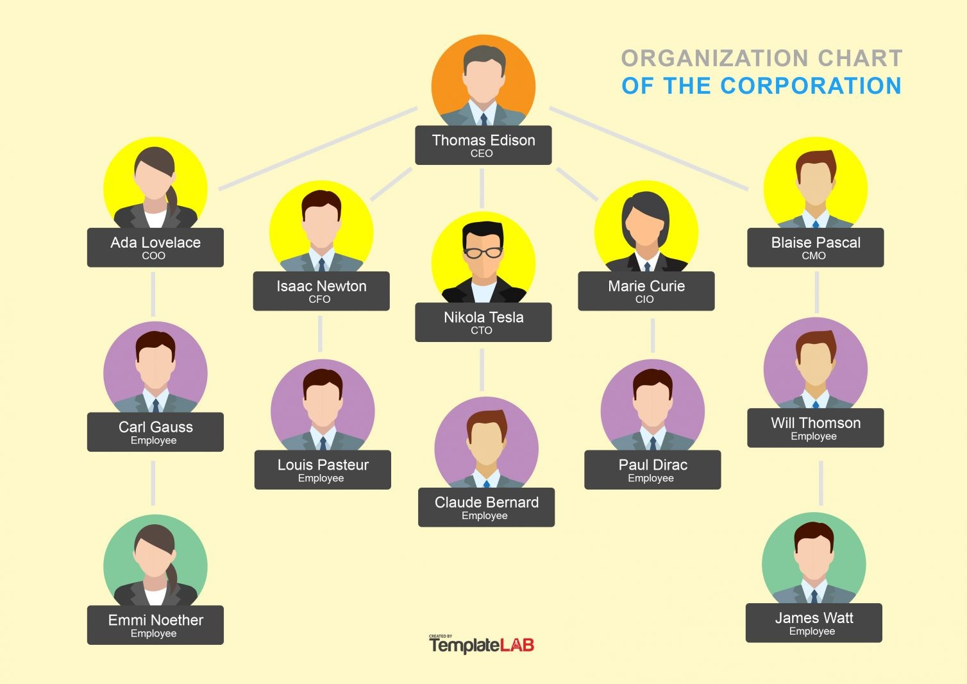

WHO ARE THE END USERS?
Employee
Employee hierarchy chart

Slide 7
OUR SOLUTION AND ITS VALUE PROPOSITION conditional formatting – to highlight the missing figures filter – to remove blanks formula – to find the number of male and female Pivot table – for summarizing graph – to visualize data

Slide 8
Dataset Description employee – kaggle 9 features employee ID – numerical name – text employee type – full time, part time and contract gender – male and female employee rating – numerical value

Slide 9

THE "WOW" IN OUR SOLUTION
=COUNTIF(U:U,"FEMALE")
=COUNTIF(U:U,"MALE")
3/21/2024 Annual Review
9

Slide 10
MODELLING
Data collection
Feature collection
Data cleaning
Summary
Visualization
10

Slide 11
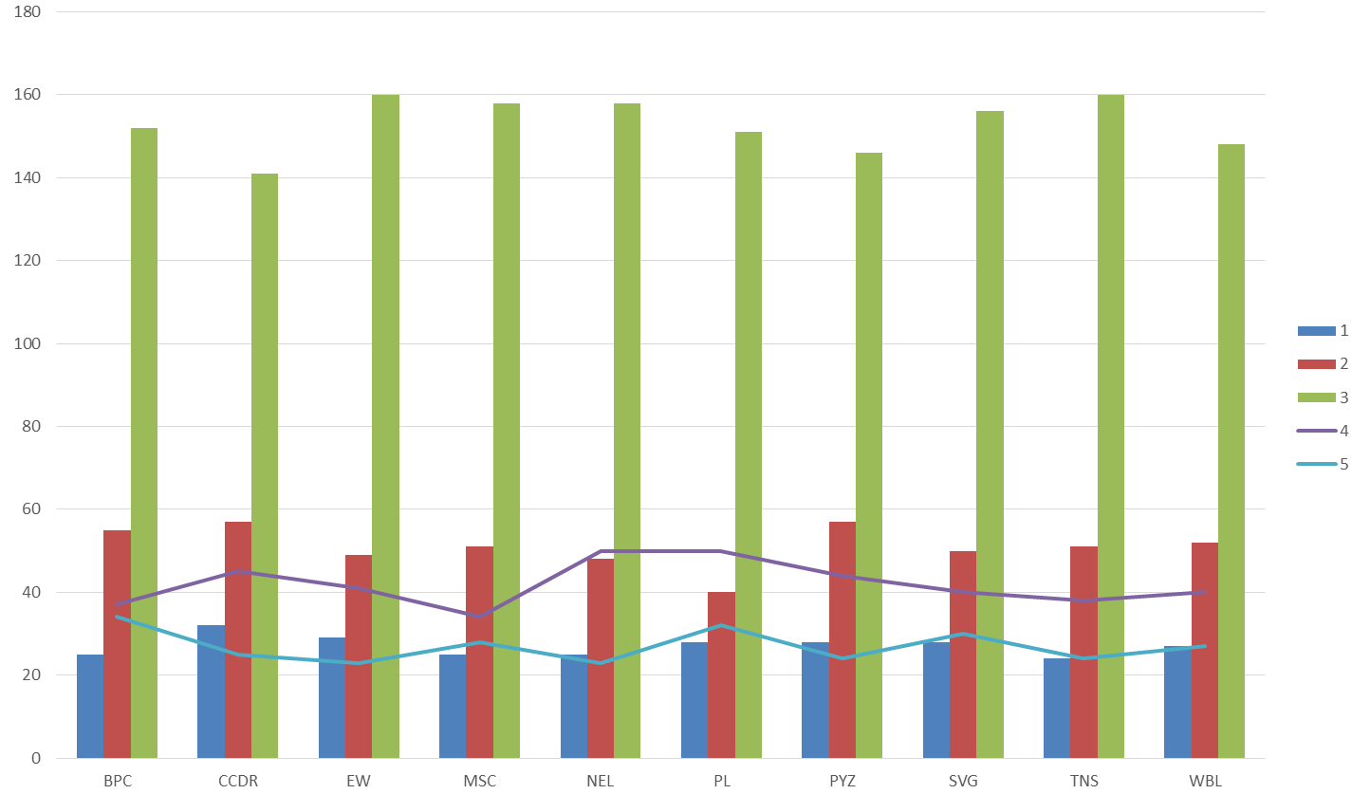
RESULTS
11

Slide 12
Conclusion Arriving at conclusion we say that, while comparing the performances of the employees, the number of average employees are higher in number in the entire organization.

